Slide 1
Web scraping to gain company insights
Scrape and analyse customer review data to uncover findings for British Airways

Slide 2
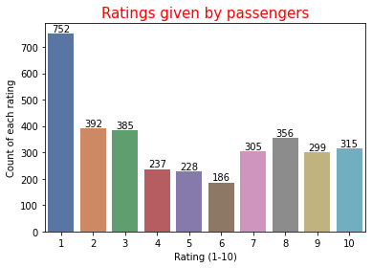
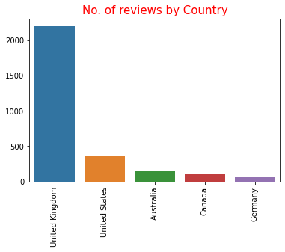
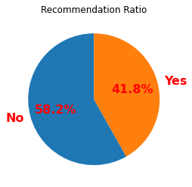
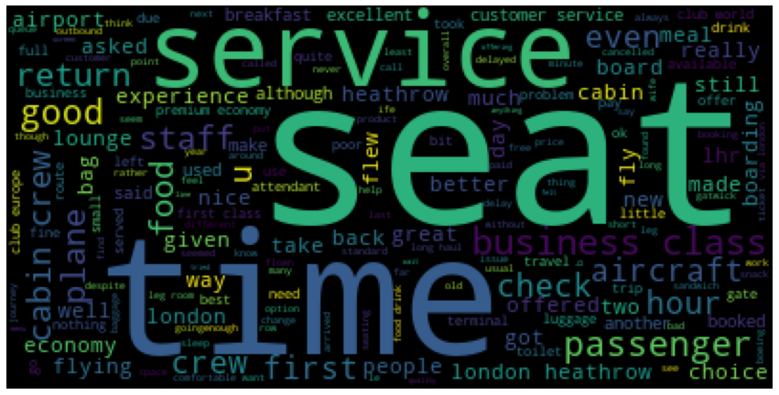
Overall Rating
5 / 10
3461 Total Reviews
58% of the passengers are not happy with
the service.
Most of them are talking about seat, time,
food, service, cabin crew, etc.
Most of the passengers are from UK.
Rating 1 is given by most of them.

